Slide 1



Slide 2
Raleigh Egypt Middle School Mission
Our mission is to create a safe environment where
students will know and understand their greatness, causing them
to exceed expectations academically, technologically, and socially
by becoming life-long learners who are able to contribute (serve) and matriculate in any environment, nationally and internationally.
Raleigh Egypt Middle School Vision
At Raleigh-Egypt Middle School, everyone can contribute and everyone can BeGreat!
Notes:
The work we will be discussing is also tightly aligned to equity in action, and while there is a direct connection to all four levers, we are going to be leaning in heavily to core instruction during our time together.

Slide 3
REMS Declaration of Contribution
I will make good things happen for other people.
I will remind myself I can ACCOMPLISH ANYTHING with time, effort, patience and RESILIENCE.
I will Do THE BEST with what I have.
I will be resourceful and responsible.
I will expect more of myself.
I will be obligated to this world and the people in it.
I will give more and continuously strive to be more.
I will BE GREAT!
Notes:
The work we will be discussing is also tightly aligned to equity in action, and while there is a direct connection to all four levers, we are going to be leaning in heavily to core instruction during our time together.

Slide 4

Notes:
The work we will be discussing is also tightly aligned to equity in action, and while there is a direct connection to all four levers, we are going to be leaning in heavily to core instruction during our time together.

Slide 5
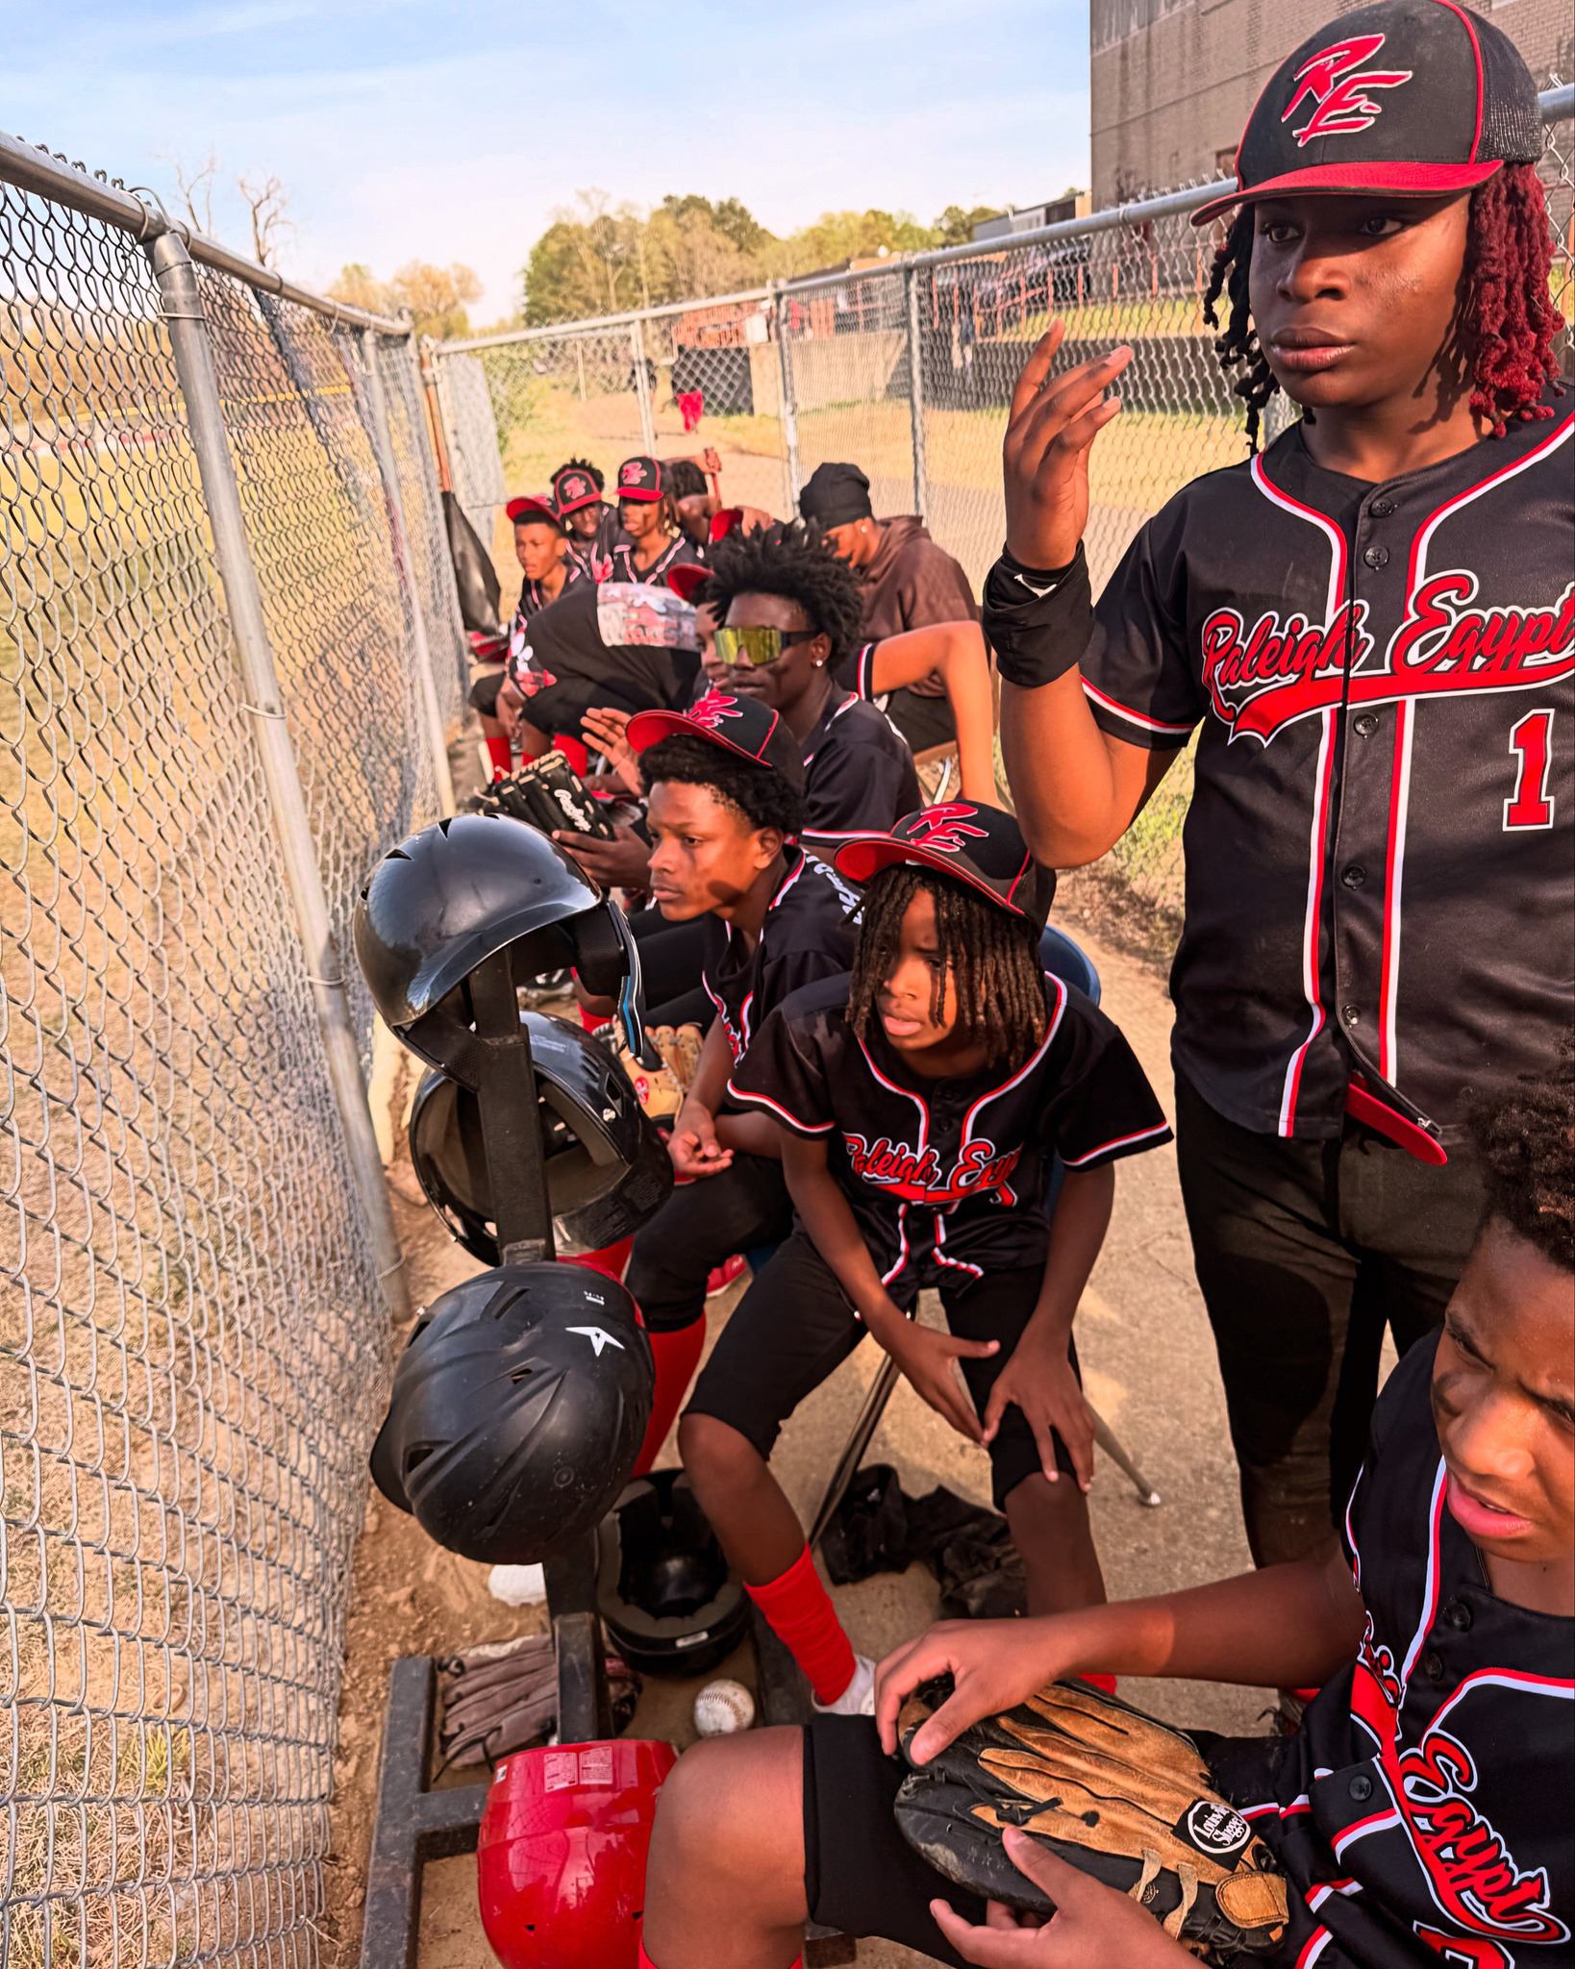
Notes:
The work we will be discussing is also tightly aligned to equity in action, and while there is a direct connection to all four levers, we are going to be leaning in heavily to core instruction during our time together.

Slide 6

Notes:
The work we will be discussing is also tightly aligned to equity in action, and while there is a direct connection to all four levers, we are going to be leaning in heavily to core instruction during our time together.

Slide 7
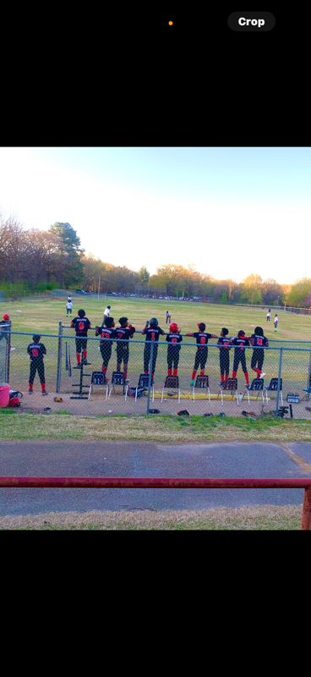
Notes:
The work we will be discussing is also tightly aligned to equity in action, and while there is a direct connection to all four levers, we are going to be leaning in heavily to core instruction during our time together.

Slide 8

Notes:
The work we will be discussing is also tightly aligned to equity in action, and while there is a direct connection to all four levers, we are going to be leaning in heavily to core instruction during our time together.

Slide 9
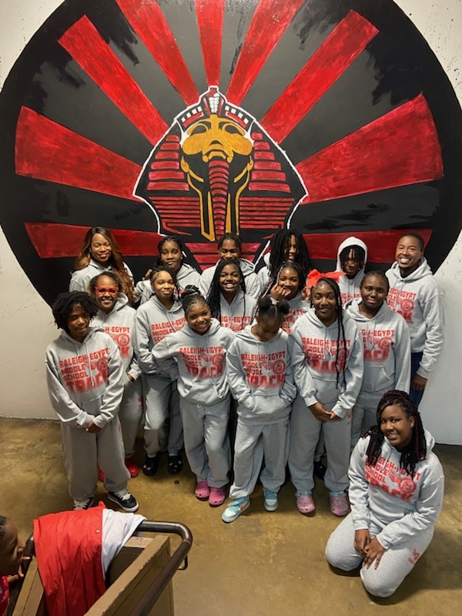
Notes:
The work we will be discussing is also tightly aligned to equity in action, and while there is a direct connection to all four levers, we are going to be leaning in heavily to core instruction during our time together.

Slide 10
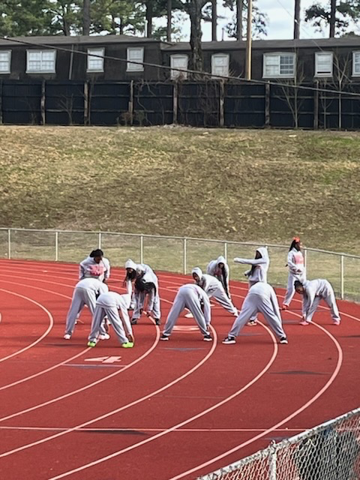
Notes:
The work we will be discussing is also tightly aligned to equity in action, and while there is a direct connection to all four levers, we are going to be leaning in heavily to core instruction during our time together.

Slide 11
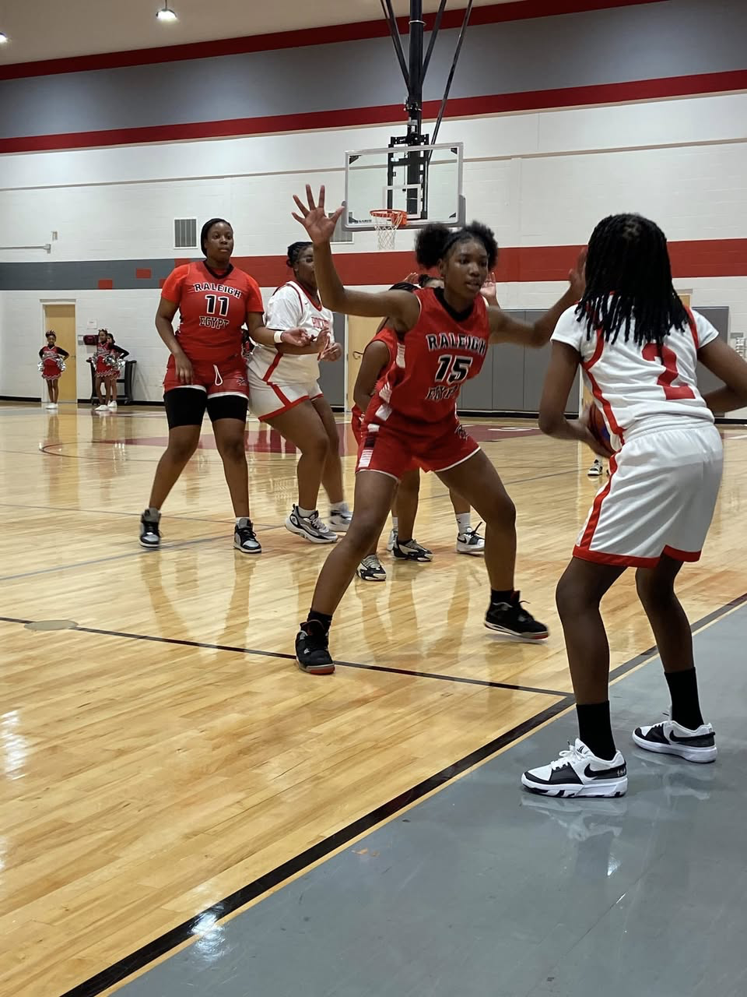
Notes:
The work we will be discussing is also tightly aligned to equity in action, and while there is a direct connection to all four levers, we are going to be leaning in heavily to core instruction during our time together.

Slide 12
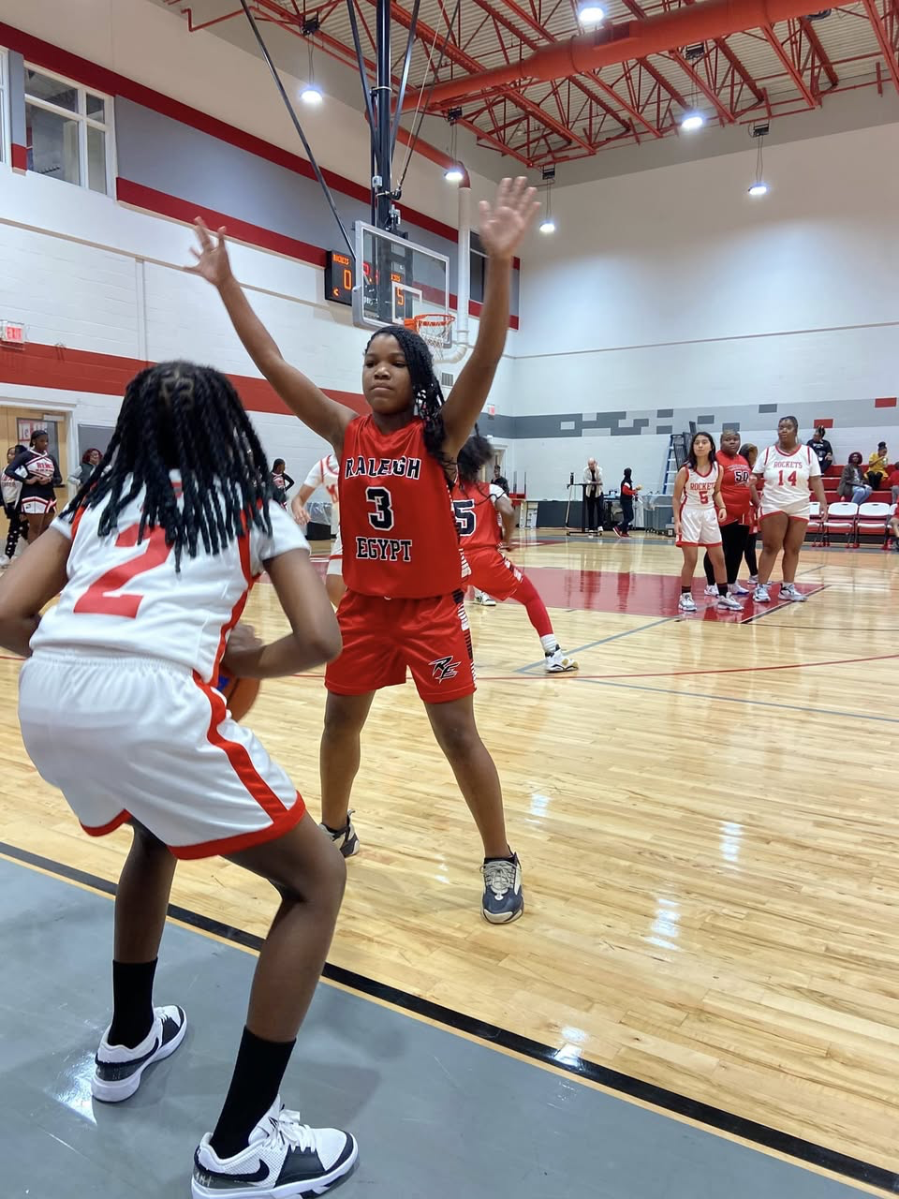
Notes:
The work we will be discussing is also tightly aligned to equity in action, and while there is a direct connection to all four levers, we are going to be leaning in heavily to core instruction during our time together.

Slide 13
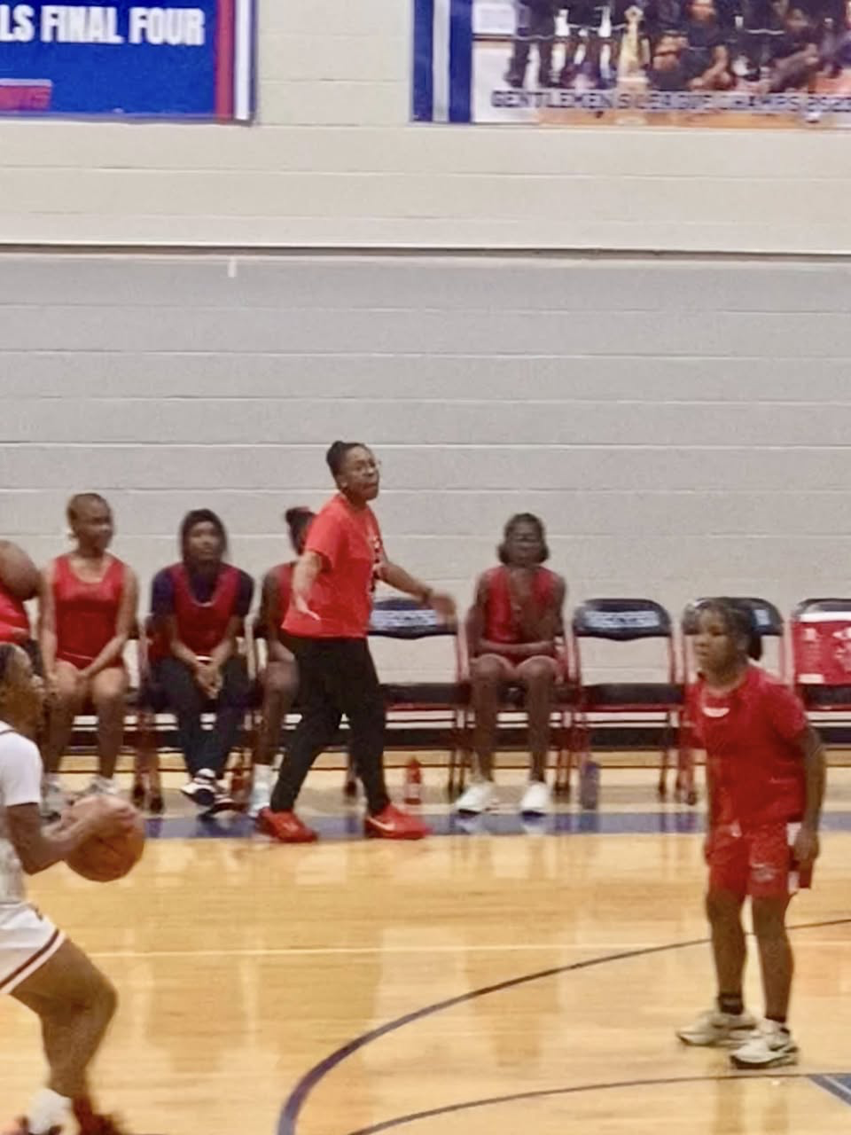
Notes:
The work we will be discussing is also tightly aligned to equity in action, and while there is a direct connection to all four levers, we are going to be leaning in heavily to core instruction during our time together.

Slide 14
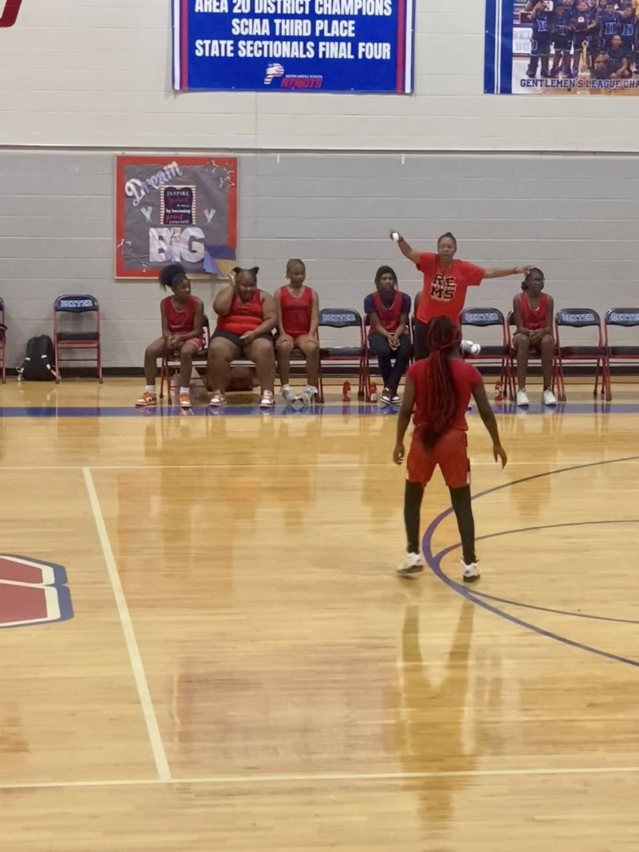
Notes:
The work we will be discussing is also tightly aligned to equity in action, and while there is a direct connection to all four levers, we are going to be leaning in heavily to core instruction during our time together.

Slide 15
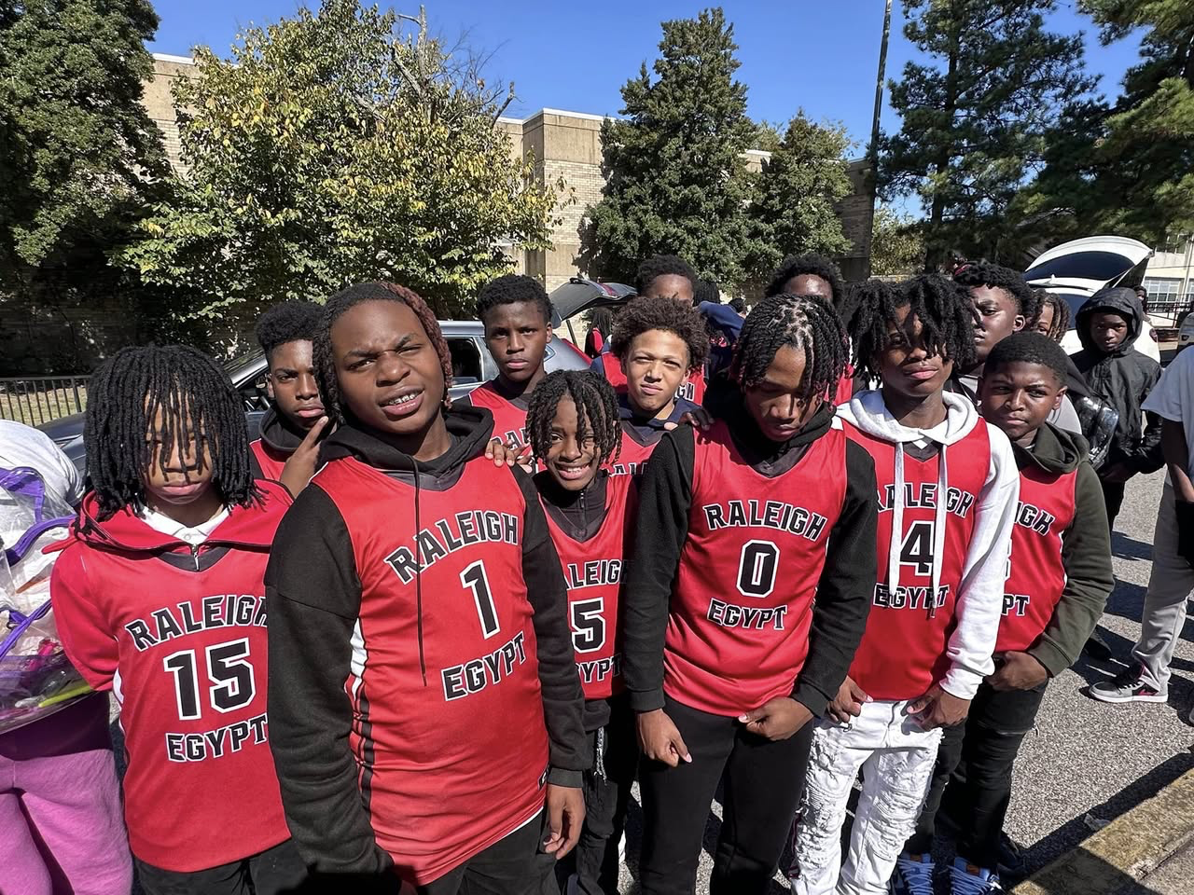
Notes:
The work we will be discussing is also tightly aligned to equity in action, and while there is a direct connection to all four levers, we are going to be leaning in heavily to core instruction during our time together.

Slide 16
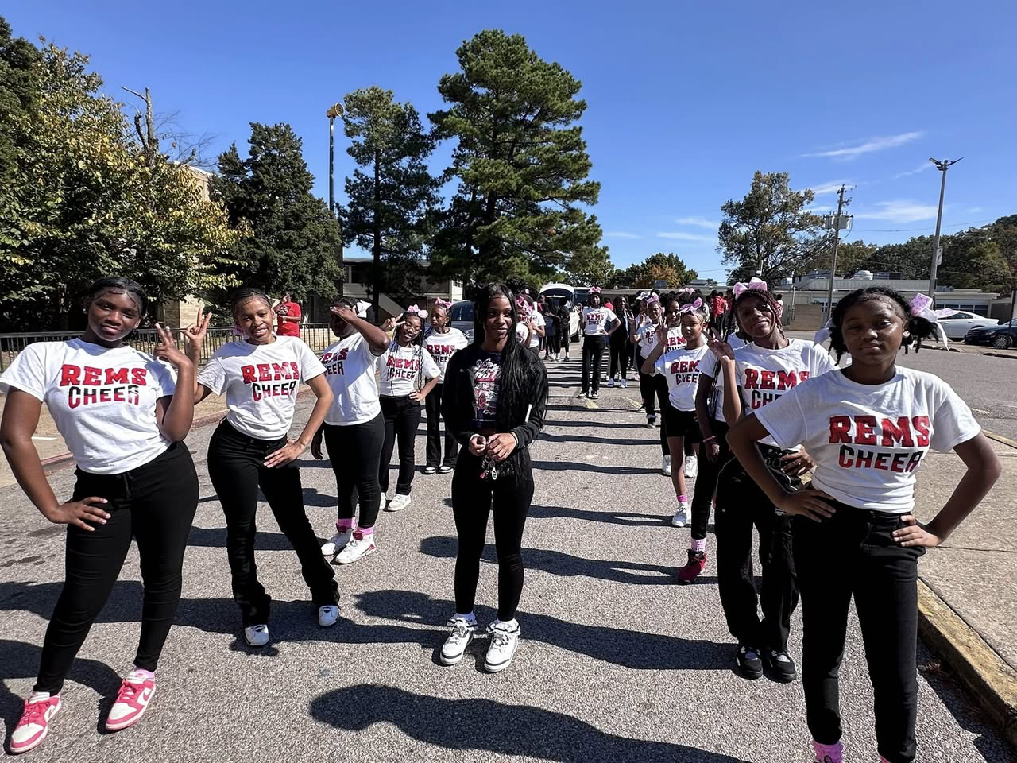
Notes:
The work we will be discussing is also tightly aligned to equity in action, and while there is a direct connection to all four levers, we are going to be leaning in heavily to core instruction during our time together.

Slide 17
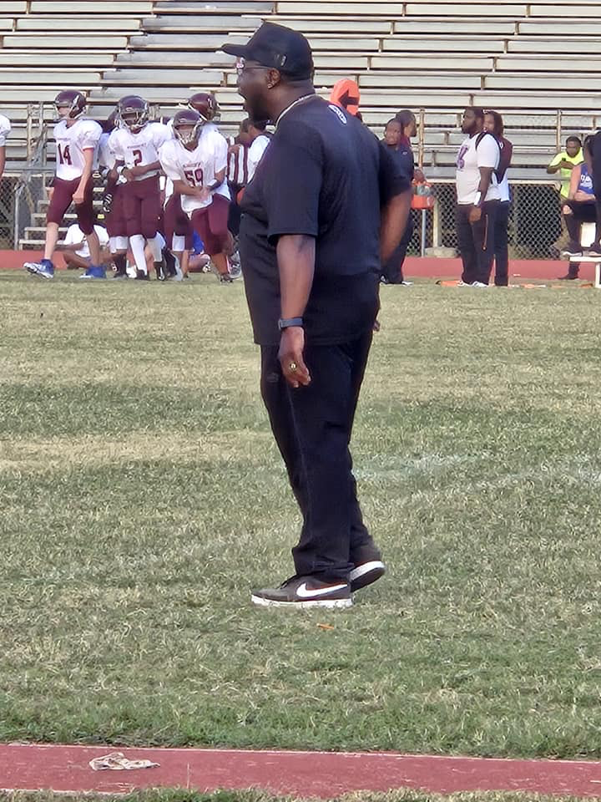
Notes:
The work we will be discussing is also tightly aligned to equity in action, and while there is a direct connection to all four levers, we are going to be leaning in heavily to core instruction during our time together.

Slide 18
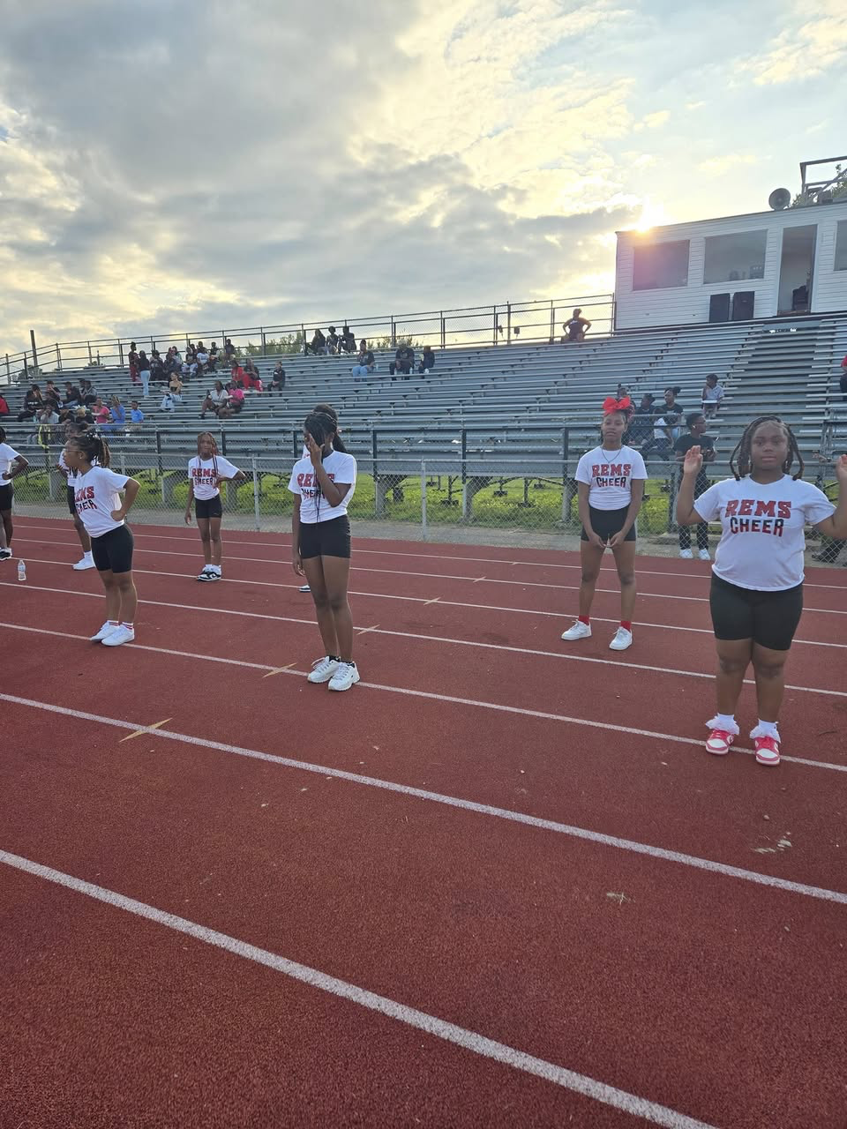
Notes:
The work we will be discussing is also tightly aligned to equity in action, and while there is a direct connection to all four levers, we are going to be leaning in heavily to core instruction during our time together.

Slide 19
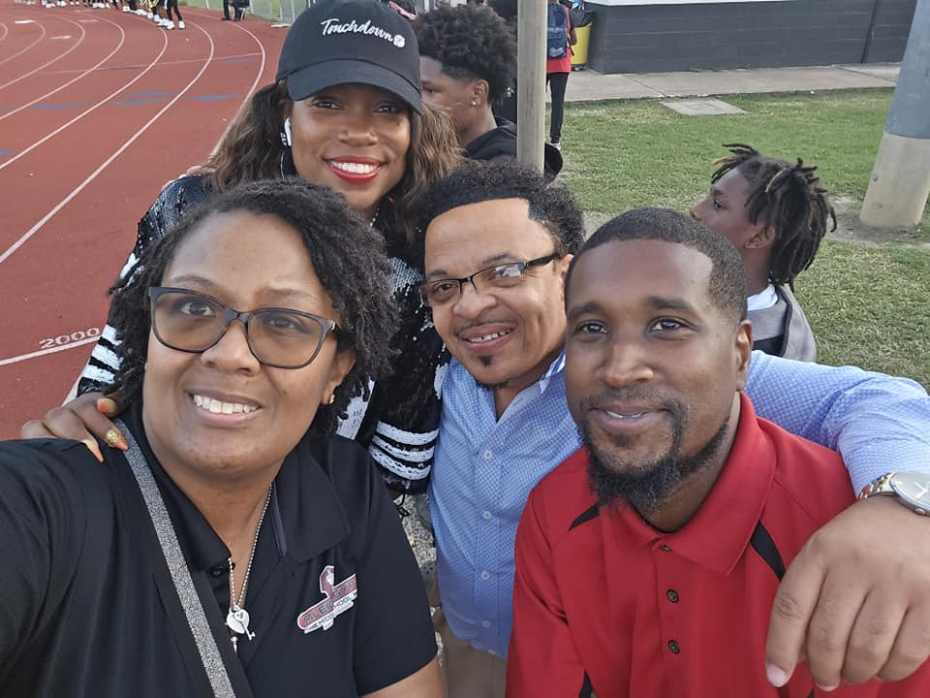
Notes:
The work we will be discussing is also tightly aligned to equity in action, and while there is a direct connection to all four levers, we are going to be leaning in heavily to core instruction during our time together.

Slide 20
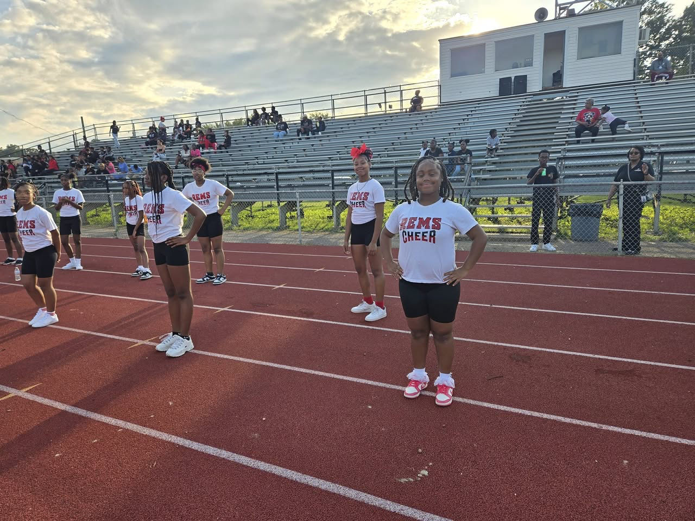
Notes:
The work we will be discussing is also tightly aligned to equity in action, and while there is a direct connection to all four levers, we are going to be leaning in heavily to core instruction during our time together.

Slide 21
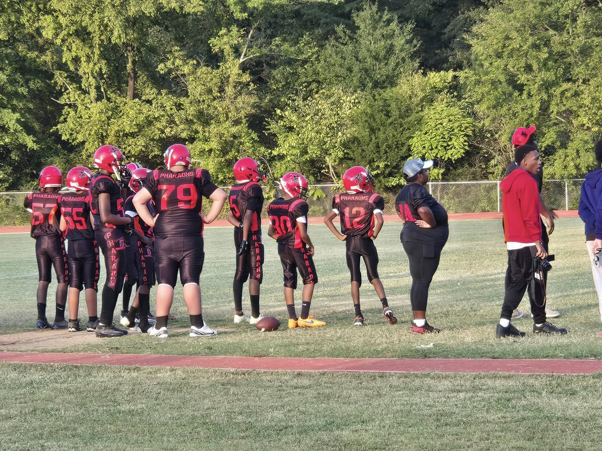
Notes:
The work we will be discussing is also tightly aligned to equity in action, and while there is a direct connection to all four levers, we are going to be leaning in heavily to core instruction during our time together.

Slide 22
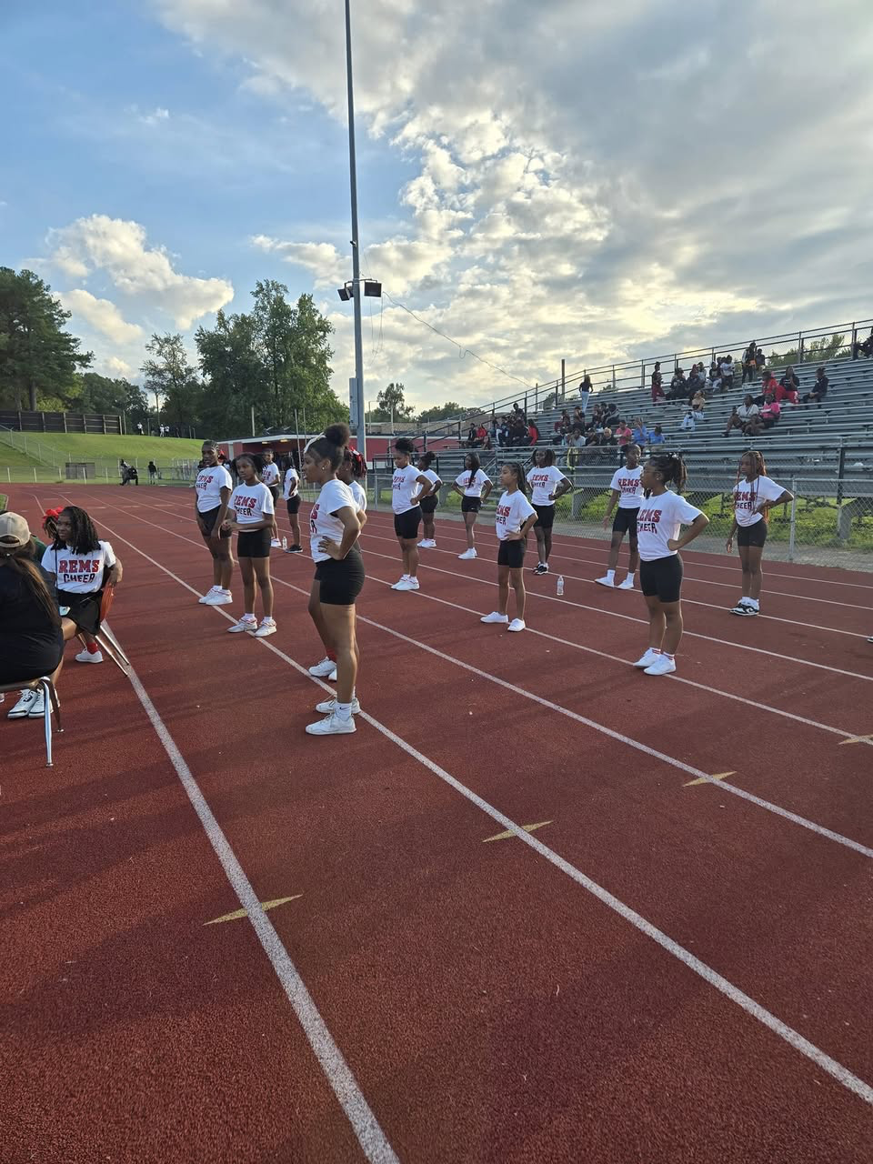
Notes:
The work we will be discussing is also tightly aligned to equity in action, and while there is a direct connection to all four levers, we are going to be leaning in heavily to core instruction during our time together.

Slide 23
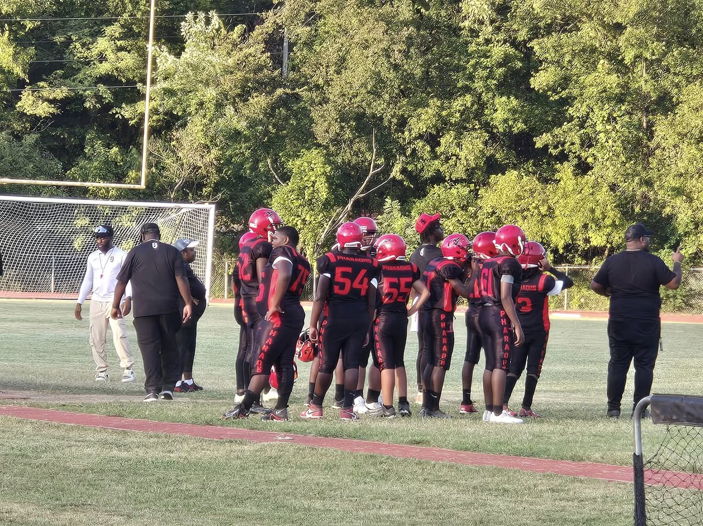
Notes:
The work we will be discussing is also tightly aligned to equity in action, and while there is a direct connection to all four levers, we are going to be leaning in heavily to core instruction during our time together.

Slide 24

Notes:
The work we will be discussing is also tightly aligned to equity in action, and while there is a direct connection to all four levers, we are going to be leaning in heavily to core instruction during our time together.

Slide 25
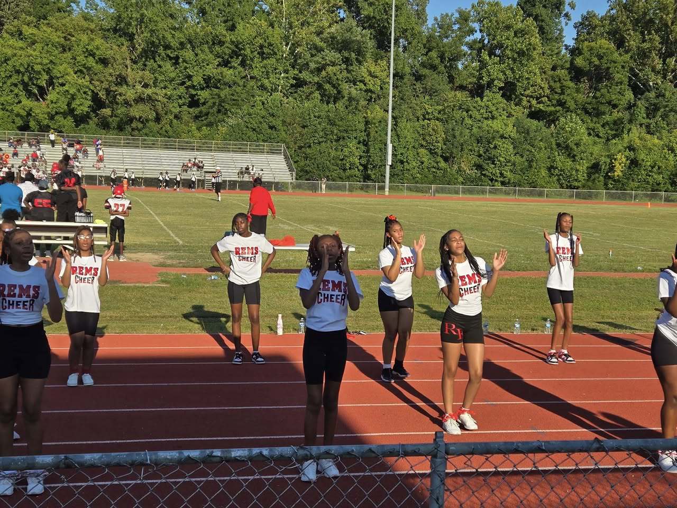
Notes:
The work we will be discussing is also tightly aligned to equity in action, and while there is a direct connection to all four levers, we are going to be leaning in heavily to core instruction during our time together.

Slide 26
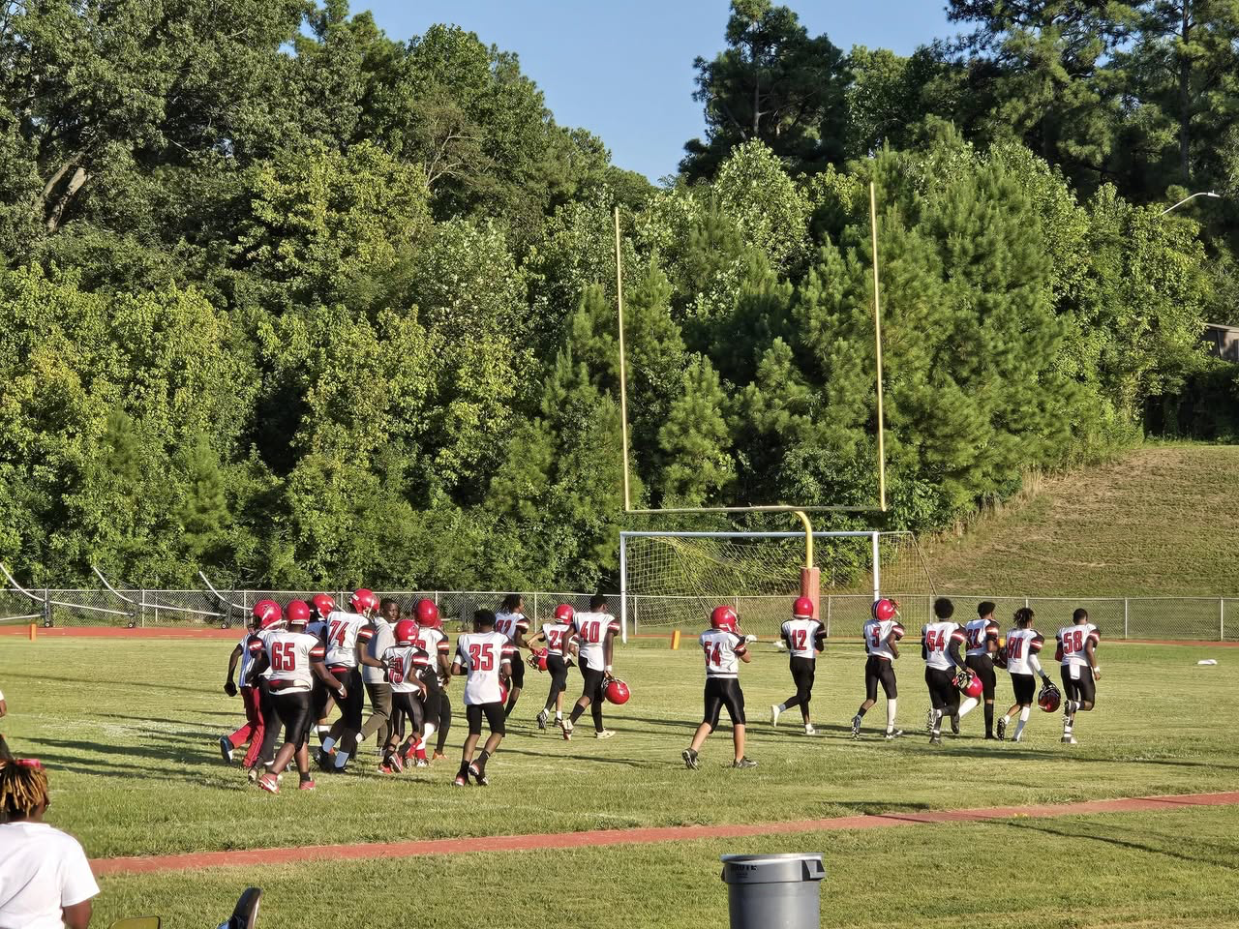
Notes:
The work we will be discussing is also tightly aligned to equity in action, and while there is a direct connection to all four levers, we are going to be leaning in heavily to core instruction during our time together.

Slide 27
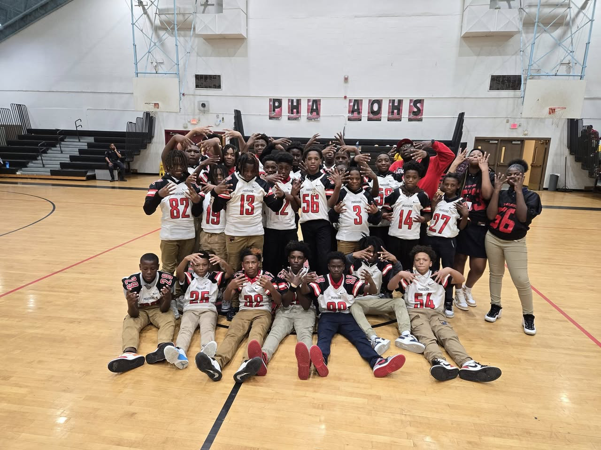
Notes:
The work we will be discussing is also tightly aligned to equity in action, and while there is a direct connection to all four levers, we are going to be leaning in heavily to core instruction during our time together.

Slide 28
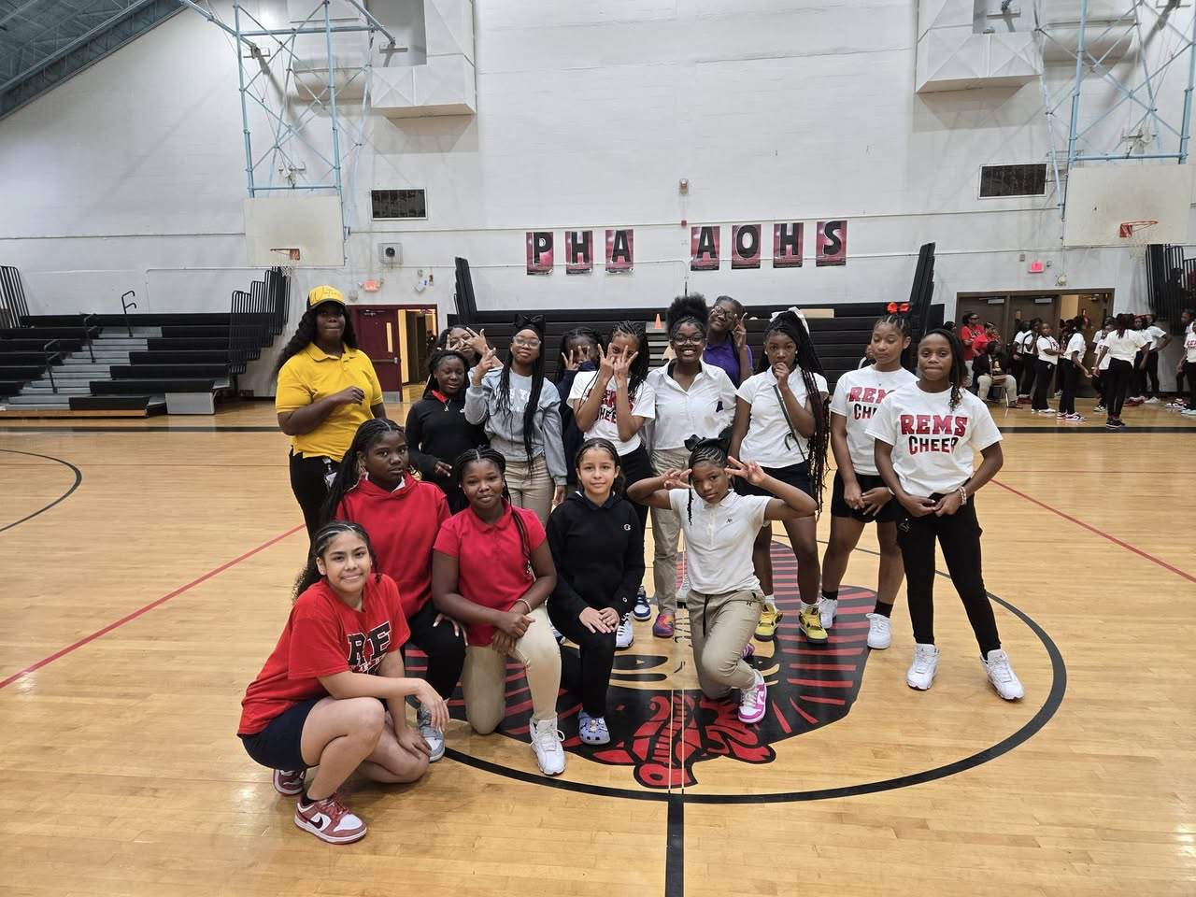
Notes:
The work we will be discussing is also tightly aligned to equity in action, and while there is a direct connection to all four levers, we are going to be leaning in heavily to core instruction during our time together.

Slide 29
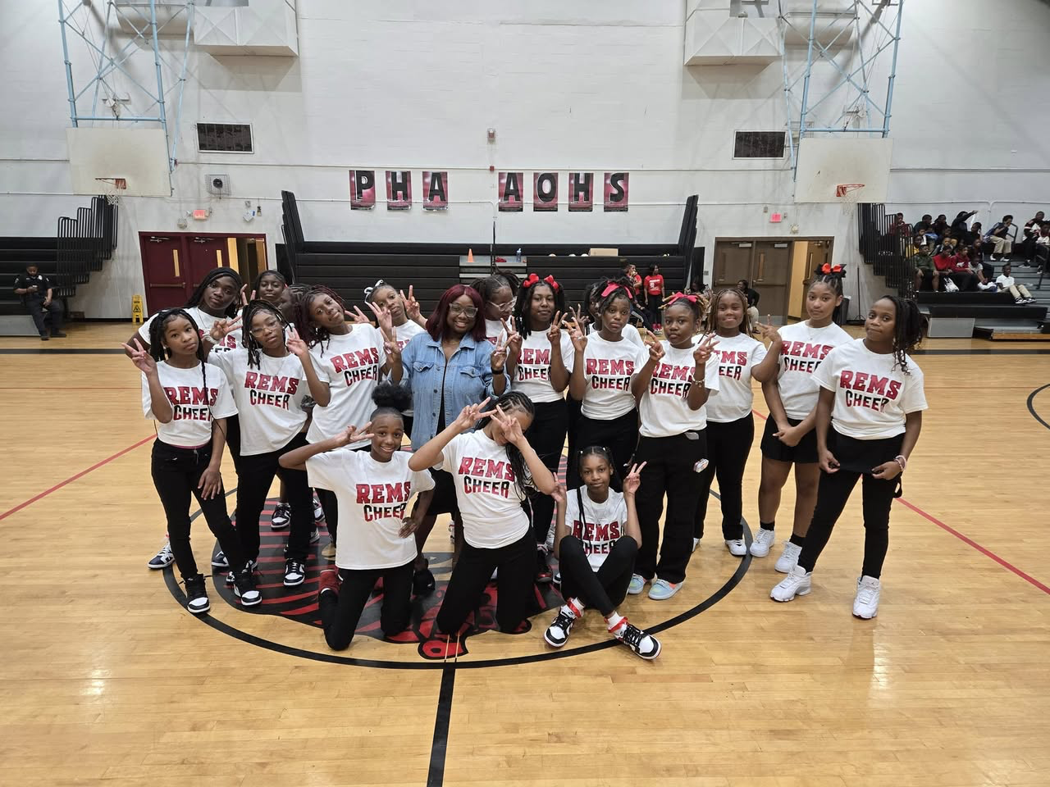
Notes:
The work we will be discussing is also tightly aligned to equity in action, and while there is a direct connection to all four levers, we are going to be leaning in heavily to core instruction during our time together.

Slide 30
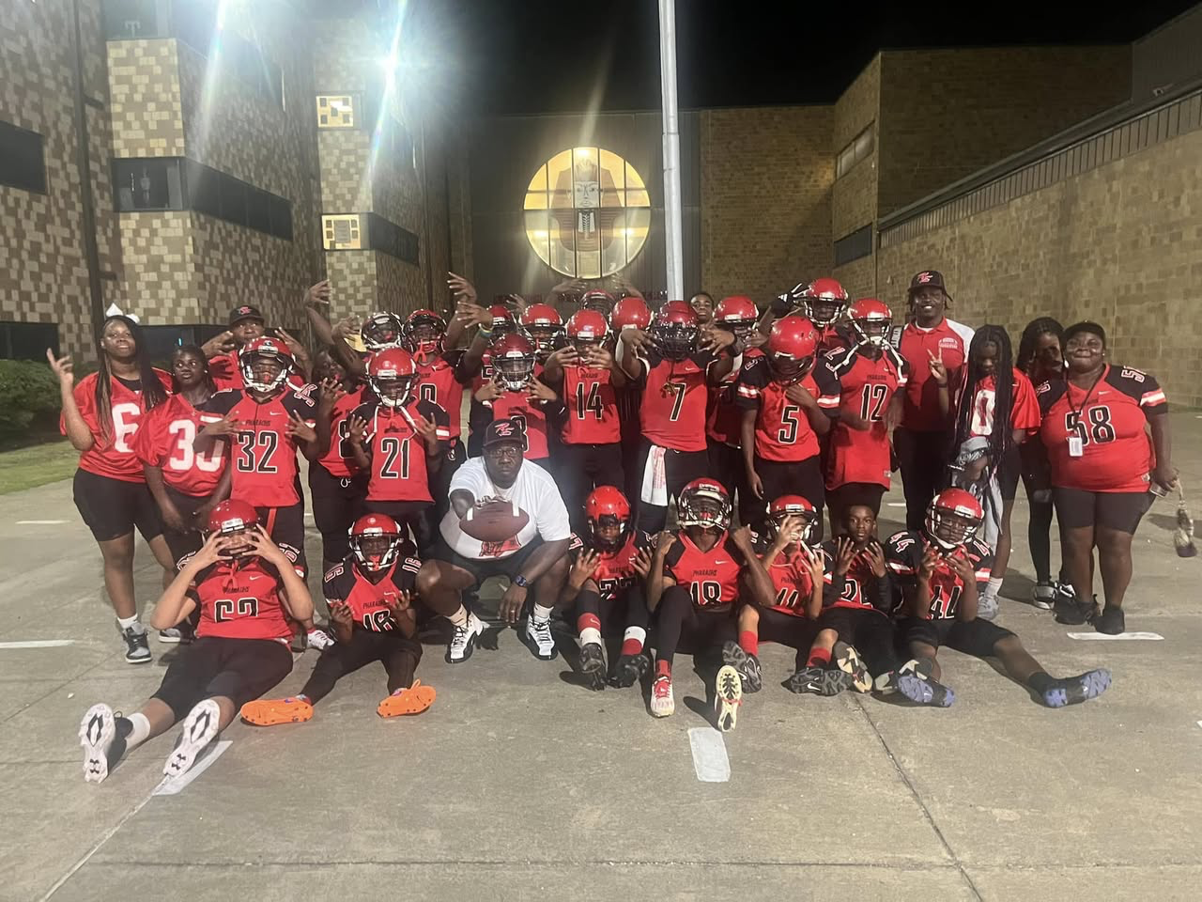
Notes:
The work we will be discussing is also tightly aligned to equity in action, and while there is a direct connection to all four levers, we are going to be leaning in heavily to core instruction during our time together.

Slide 31
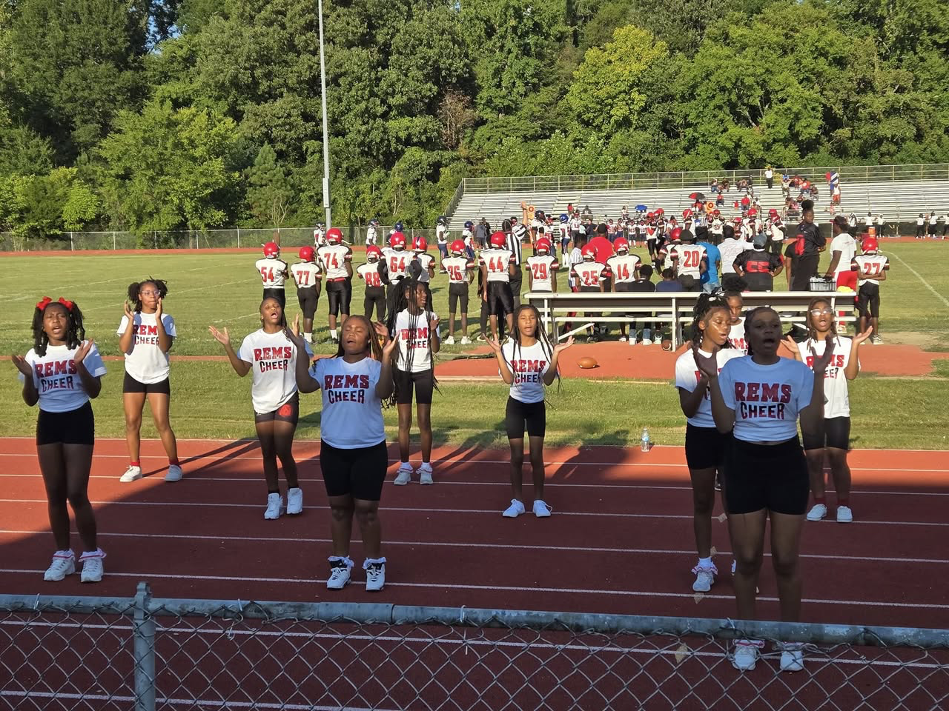
Notes:
The work we will be discussing is also tightly aligned to equity in action, and while there is a direct connection to all four levers, we are going to be leaning in heavily to core instruction during our time together.

Slide 32

Notes:
The work we will be discussing is also tightly aligned to equity in action, and while there is a direct connection to all four levers, we are going to be leaning in heavily to core instruction during our time together.

Slide 33
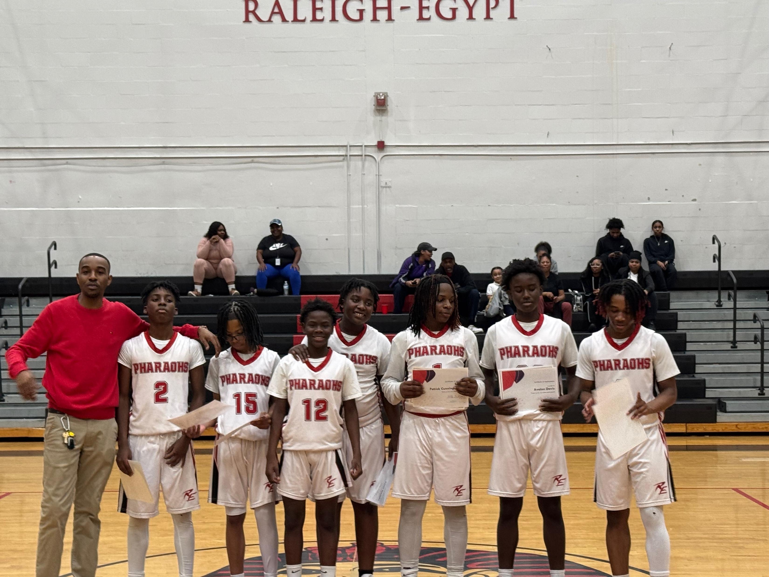
Notes:
The work we will be discussing is also tightly aligned to equity in action, and while there is a direct connection to all four levers, we are going to be leaning in heavily to core instruction during our time together.

Slide 34
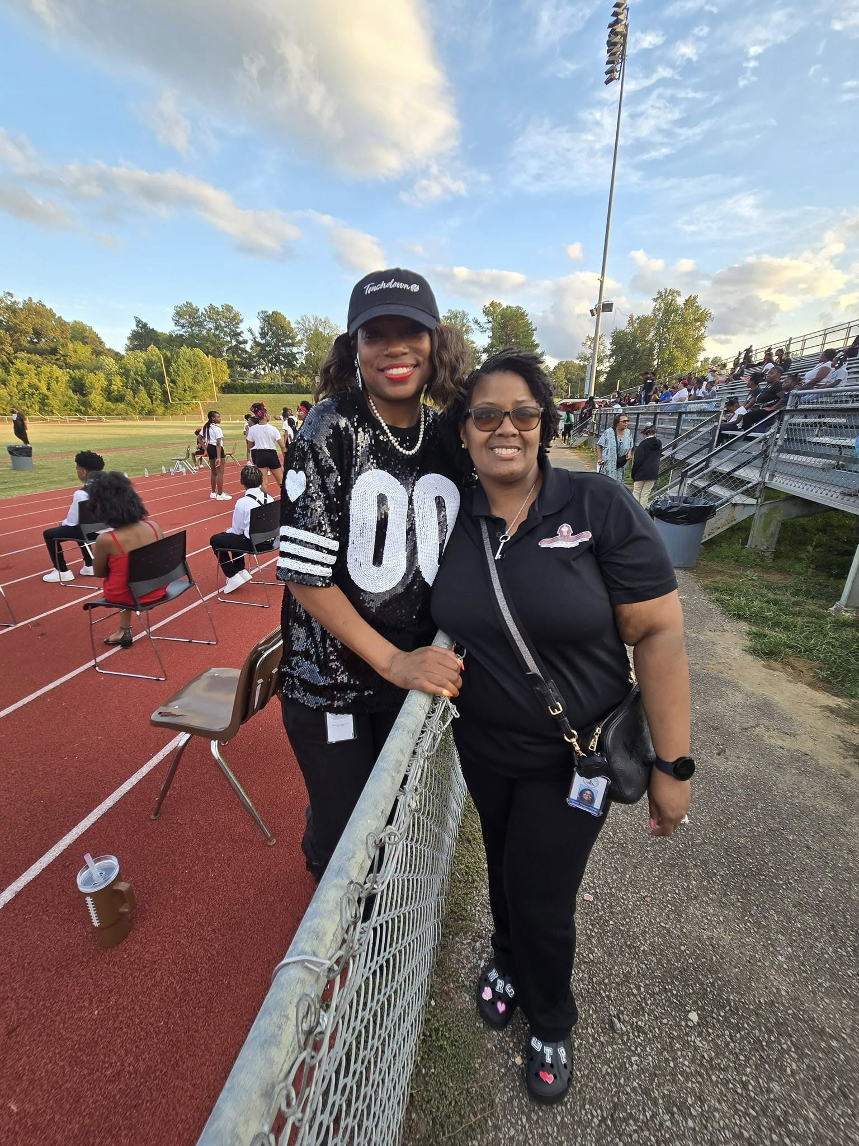
Notes:
The work we will be discussing is also tightly aligned to equity in action, and while there is a direct connection to all four levers, we are going to be leaning in heavily to core instruction during our time together.

Slide 35

Notes:
The work we will be discussing is also tightly aligned to equity in action, and while there is a direct connection to all four levers, we are going to be leaning in heavily to core instruction during our time together.

Slide 36
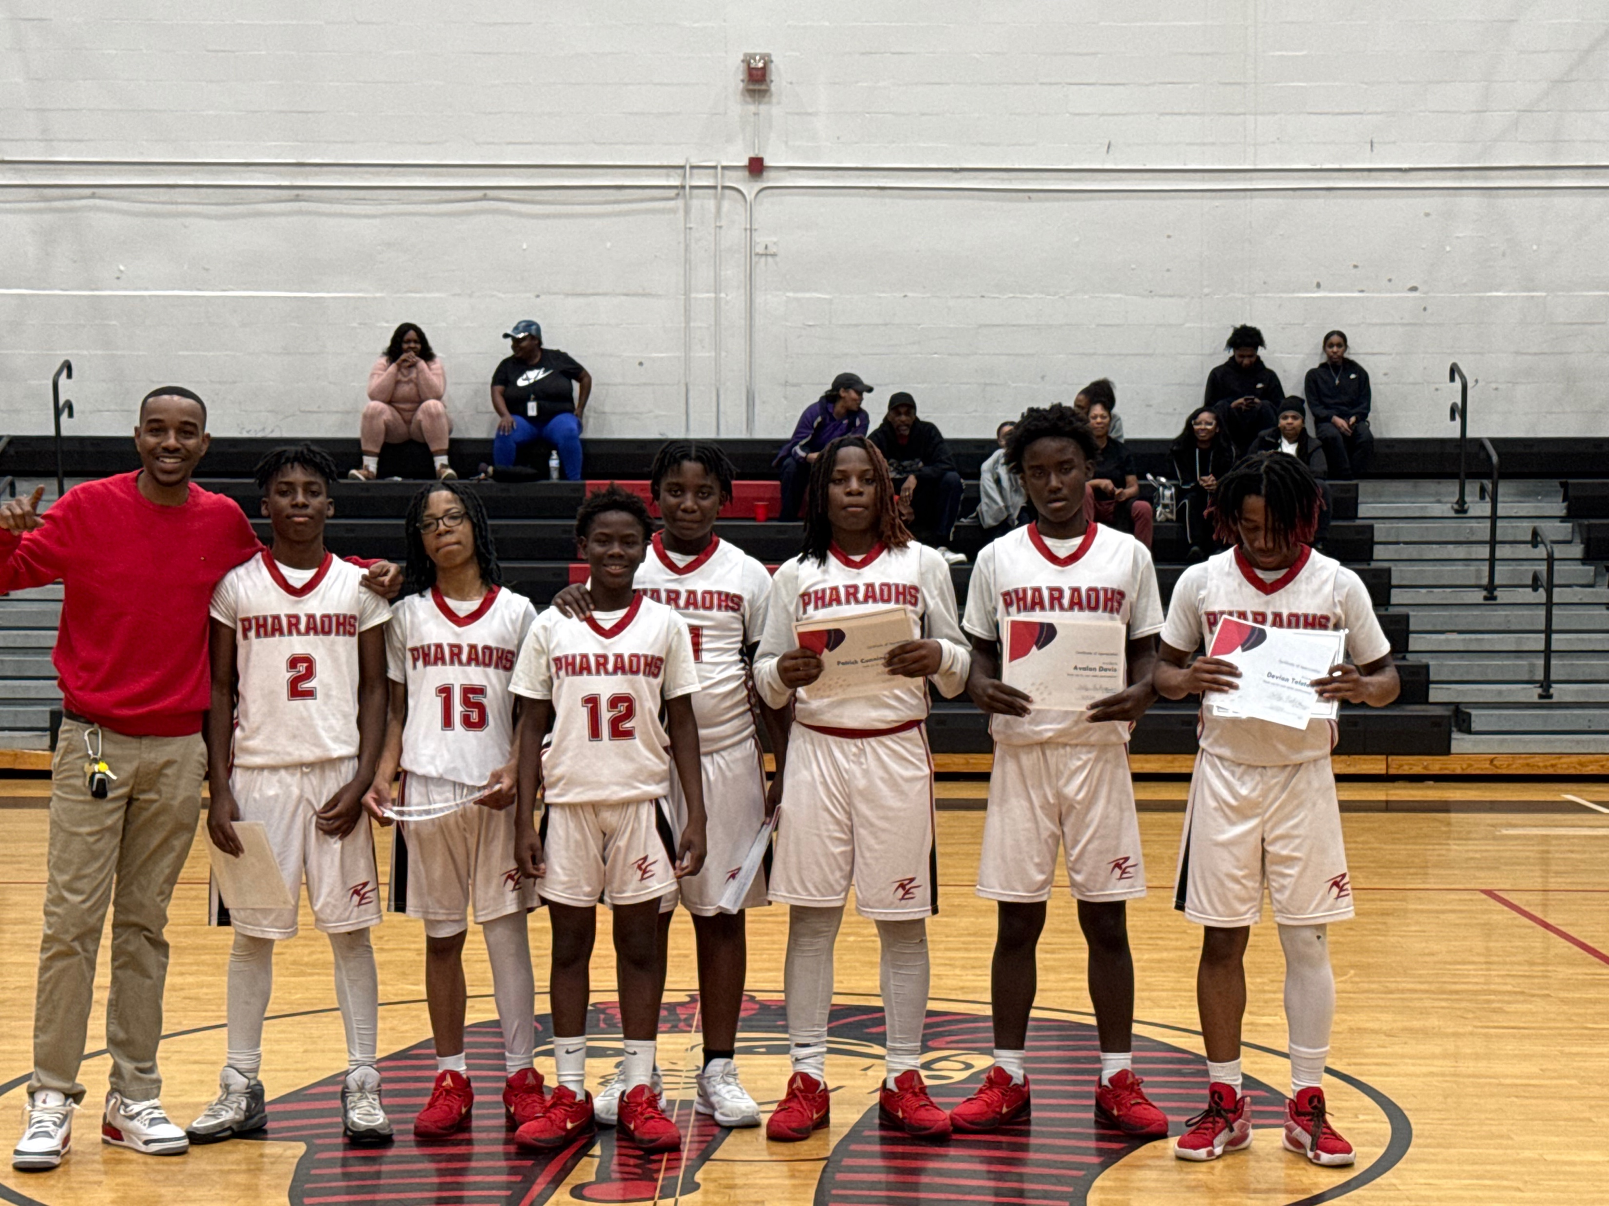
Notes:
The work we will be discussing is also tightly aligned to equity in action, and while there is a direct connection to all four levers, we are going to be leaning in heavily to core instruction during our time together.

Slide 37
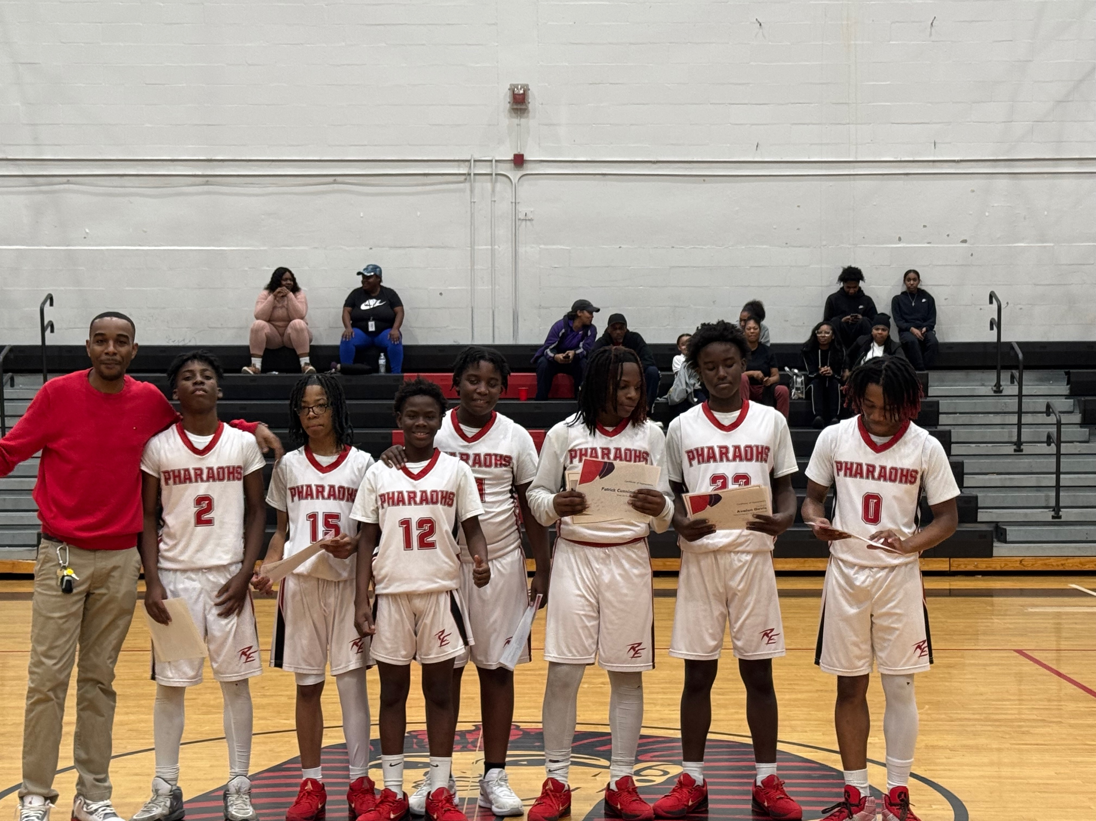
Notes:
The work we will be discussing is also tightly aligned to equity in action, and while there is a direct connection to all four levers, we are going to be leaning in heavily to core instruction during our time together.

Slide 38
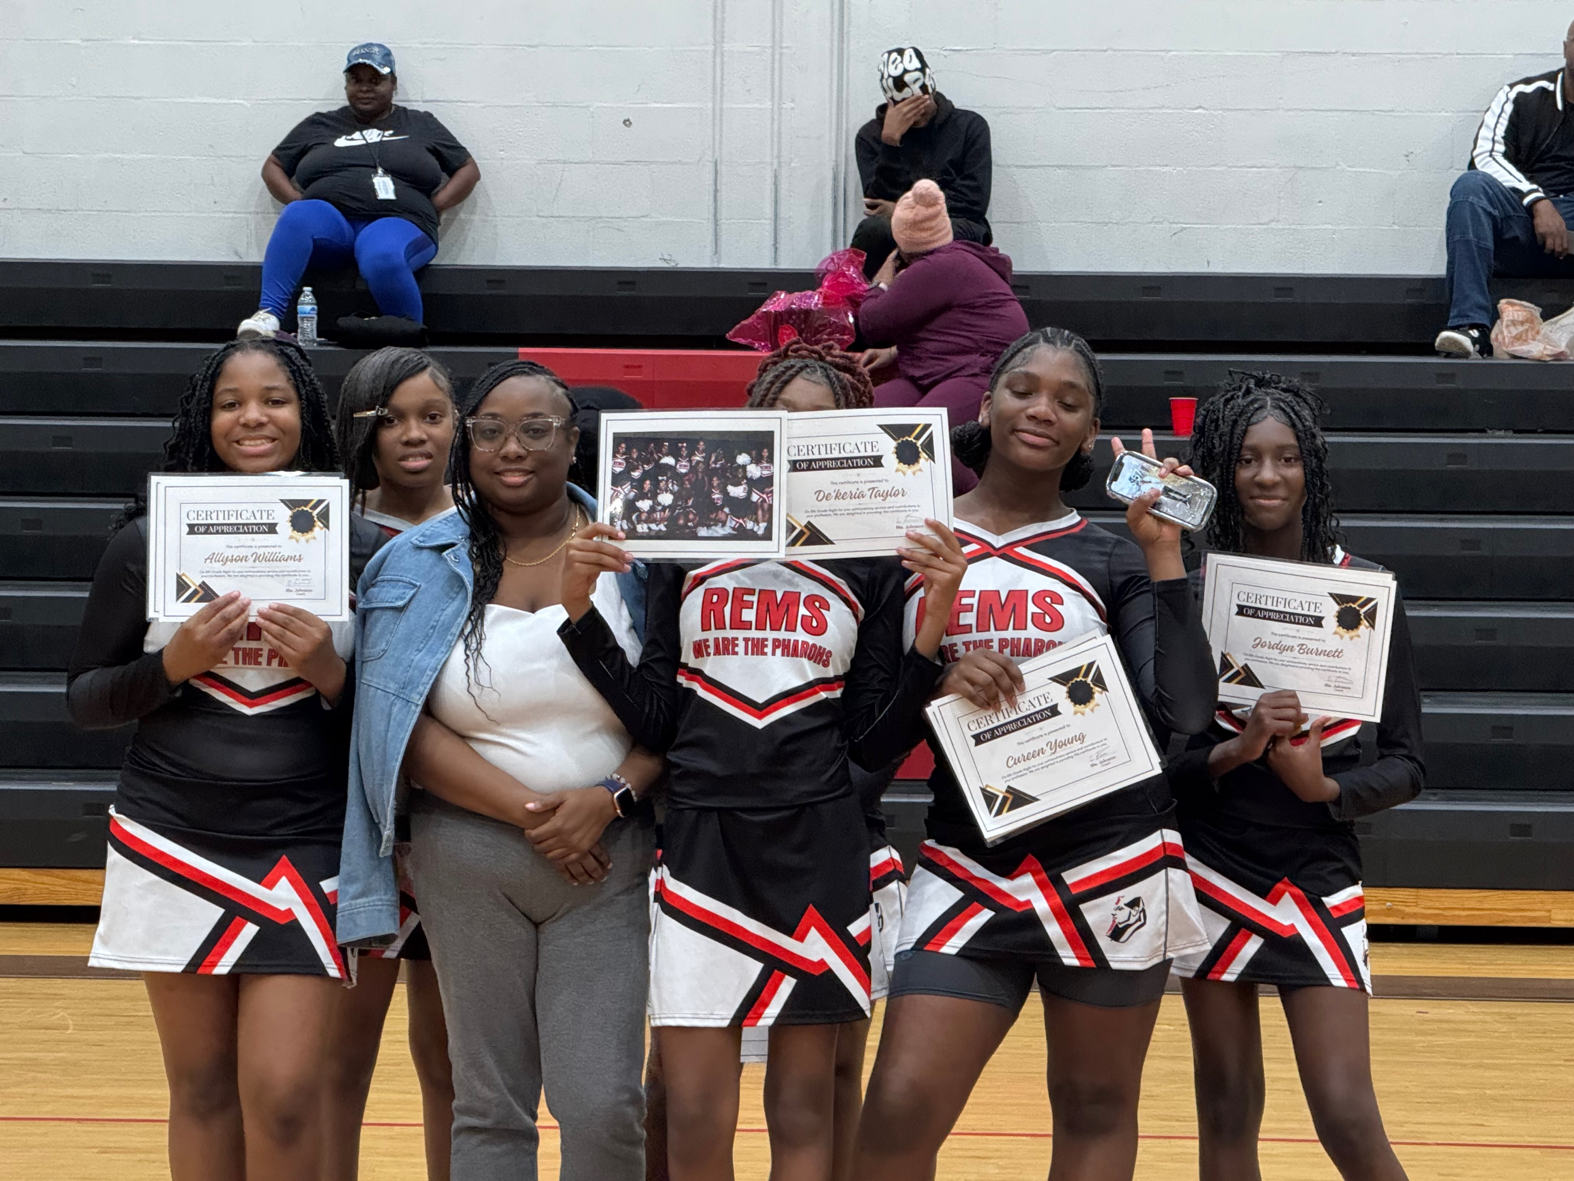
Notes:
The work we will be discussing is also tightly aligned to equity in action, and while there is a direct connection to all four levers, we are going to be leaning in heavily to core instruction during our time together.

Slide 39
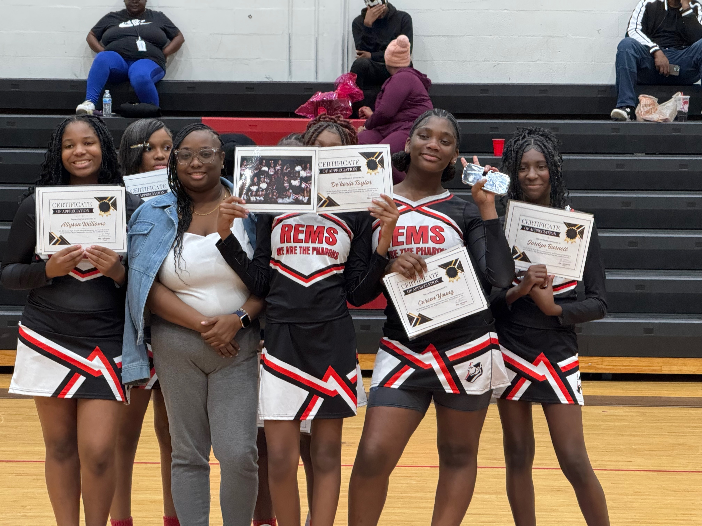
Notes:
The work we will be discussing is also tightly aligned to equity in action, and while there is a direct connection to all four levers, we are going to be leaning in heavily to core instruction during our time together.

Slide 40
Notes:
The work we will be discussing is also tightly aligned to equity in action, and while there is a direct connection to all four levers, we are going to be leaning in heavily to core instruction during our time together.

Slide 41
Notes:
The work we will be discussing is also tightly aligned to equity in action, and while there is a direct connection to all four levers, we are going to be leaning in heavily to core instruction during our time together.

